Slide 1








Help
UC1+UC3+UC4+UC5:
Main menu
Buccaneer
Takes you to the nickname screen
Takes you to the rule screen
Start
Continue
Exit

Slide 2



Buccaneer
Help
Please enter your name
Player 1
Player 2
UC2:
Entering player names
Player 3
Player 4
Start
Takes you to the game screen

Slide 3

Buccaneer
Back
Player 1
How to Play:
- Each player gets 1 ship and 5 crew cards
- The rest of the treasures are placed on the Treasure Island.
- The rest of the crew cards are placed face down on the Pirate Island.
- When it is your turn, you may do one of the following:
- Sail to treasure island and draw a Chance card.
~ Follow the instruction on the Chance card.
- Sail to another harbour to trade.
~ You may exchange treasures and crew cards on the harbour with the ones you have on your ship.
- Attack another player's ship.
~ Sail to the same square as them and shout "Ready to Attack".
~ Both players must reveal their combat values.
~ The player with the higher combat value wins the battle.
~ Winner chooses either 2 Crew cards or all the treasure on the losing ship.
- Treasures stores in safe zones cannot be traded or stolen.
UC3:
Help screen
Player 2
Player 3
Player 4
Start

Slide 4
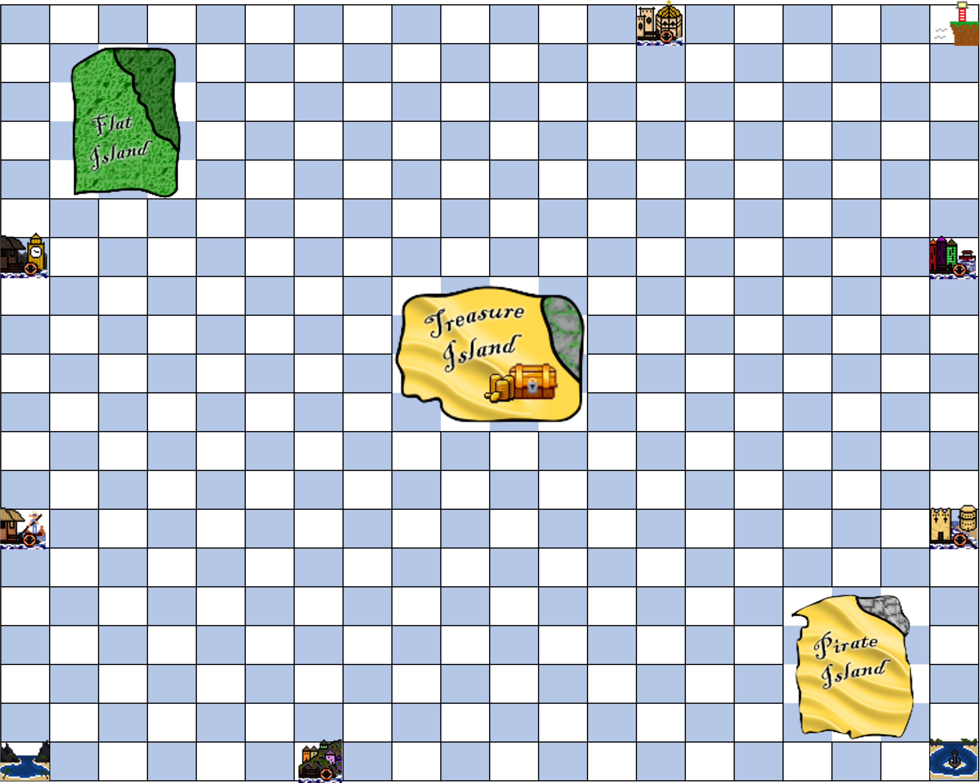

UC6+UC7+UC8:
Game screen when it is a players turn, they have the option of turning or moving. They can move by clicking one of the green squares available
Player 1 – Would you like to move your ship or turn?
Move
Turn
Shows available tiles

Slide 5
UC6+UC7+UC8:
Game screen when it is a players turn, they have the option of turning or moving. They can move by clicking one of the green squares available
Player 1
End turn
Ends your turn

Slide 6
UC6+UC7+UC8:
If the user selects move, then the spaces that the user will be able to move will be displayed
Player 1 – Would you like to move your ship or turn?
Press to move ship
Move
Turn

Slide 7
UC6+UC7+UC8:
If the user selects move, then the spaces that the user will be able to move will be displayed
Player 1 – Would you like to move your ship or turn?
Press to rotate ship
Move
Turn

Slide 8
UC9:
The player has now moved position and can end their turn
Player 1
End Turn
Press to end the users turn

Slide 9









Congratulations
Player 3 has won!
End Game Start New Game
Press to take the user back to the nickname menu
UC20:
Winning screen once a player has won the game. This displays the players ship and the treasures they collected. End game will close the application while Start new game will take them to the main menu

Slide 10

Player 1
You are blown to your Home Port. If your crew total is 3 or less, take 4 crew cards from Pirate Island
UC12+UC15:
Displays the card and its instructions
Example 1
Example 2
Example 3
Example 4

Slide 11
Player 1
You are blown to your Home Port. If your crew total is 3 or less, take 4 crew cards from Pirate Island
UC12+UC15:
The instructions of the card have been followed and the player has been blown to their home port

Slide 12

Rules
Chance card #3
You are blown to Mud Bay. If your crew total is 3 or less, take 4 crew cards from Pirate Island.
Close
Click here to go back to the game screen with the player data shown
UC13 & UC17: Chance card effect: give/take crew cards from places (for e.g. card 3)
Player is dealt this chance card. Consequences are implemented and the player receives the specified amount of crew cards.

Slide 13
Rules
Chance card #2
Present this card to any player who must then give you 3 crew cards. This card must be used at once then returned to the Chance card pack. Choose a player:
Close
Click here to go back to the game screen with the player data shown
UC14: Chance card effect: give/take crew cards from players (for e.g. card 2)
Player is dealt this chance card to present to other player of their choosing. Card must be used at once then returned to pack.

Slide 14
Rules
Chance card #23
You received: Doubloons!
- This card may be traded for crew or treasure up to value 5 in any port you visit. Keep this card.
Close
Click here to go back to the game screen with the player data shown
UC15: Chance card effect: give/take treasures from places (for e.g. card23)
Player is dealt this chance card to keep. They can use this card for trading with treasures or crew and must be returned to the chance card pack once used.

Slide 15
Rules
Chance card #7
One treasure from your ship or 2 crew cards from your hand are lost and washed overboard to the nearest ship. If 2 ships are equidistant from yours, you may ignore this instruction.
You have lost your least valuable treasure
x1 to
Close
Click here to go back to the game screen with the player data shown
UC16: Chance card effect: give/take treasures to other players (for e.g. card7)
Player loses valuables from their hands (either treasure or crew), the lowest value treasure or crew is given to nearest player.

Slide 16


UC6:
Provides info on certain things such as player data, port data, and island data
Flat Island
Cards
Treasures
Player 1 – Would you like to move your ship or turn?
Move
Turn

Slide 17

Player Data
Cards
Treasures
UC6:
Provides info on certain things such as player data, port data, and island data
Player 1 – Would you like to move your ship or turn?
Move
Turn

Slide 18

UC10:
If a player selects a square already occupied, they will be informed they will have to battle the other player
Player 1 – If you move to this position you will have to attack player 3
Ready to attack?
Takes the user to the battle screen

Slide 19
Battle!
Player 1 Player 3
Player 1 has won the battle
UC10:
Battle screen which gets initiated if a player selects the “Ready to attack?” button
Take 2 Crew Cards
Treasure
Takes the user back to the game screen and shows the treasure they have won

Slide 20
Player 1
You won the battle
You have been awarded the following treasures:
1x Diamond
1x Barrel of rum
UC10:
After a user has won a battle, the game then indicates the user who won the battle and what they have won

Slide 21
Rules
Deposit at your harboaur?
Please select the treasure or crew cards you wish to deposit
x3
UC18:
If a player sails back to his own harbour he can place their treasures safely at the harbour
Deposits the treasure into the harbour

Slide 22
Rules
You have successfully deposited the following treasures in your harbour:
x3
UC18:
If a player sails back to his own harbour he can place their treasures safely at the harbour

Slide 23


Flat Island
You have found the following treasure!
You only have room for 1 of the treasures. You will be given the one with the highest value
UC19:
If a player sails next to flat island they can collect any treasure there
OK
Takes the user back to the game screen

Slide 24
Trading
Your Items Available Treasures
UC11:
Trading screen which is initiated when a player reaches a harbour which is not their own
Crew Cards
Treasures
OK
Takes the user back to the game screen

